Slide 1
Prime Areas Workshop
Please sign in by the front door so we know which children to collect from which class.

Slide 2
Areas of Learning
In Early Years our curriculum is broken down into two parts:
Prime areas of learning: Communication and Language
Physical Development
Personal, Social and Emotional Development
Specific areas of learning: Literacy
Maths
Understanding the World
Expressive Art and design
Notes:
Discuss areas of learning.

Slide 3
Communication and Language
Language rich environment - Children’s communication and language is strengthened through the number of conversations/ interactions they have with adults throughout the day.
This can be further enhanced through songs, rhymes, story-telling and role play, where children share their ideas with support and modelling from adults around them.
Questioning – children’s communication skills can be extended through questioning - By inviting them to elaborate, it enables them to become more comfortable to use a rich range of vocabulary and language structures.

Slide 4
Physical Development
Physical activity is vital in children’s all-round development, enabling them to pursue happy, healthy and active lives.
Gross Motor
Gross motor skills provide the foundation for developing healthy bodies and social and emotional well-being.
By providing opportunities for play both indoors and outdoors, adults can support children to develop their core strength, stability, balance, spatial awareness, co-ordination and agility.
Fine Motor
Fine motor control and precision helps with hand-eye co-ordination, which is later linked to early literacy.

Slide 5
Personal, Social and Emotional Development
Children’s personal, social and emotional development (PSED) is crucial for children to lead healthy and happy lives, and is fundamental to their cognitive development.
We support children to manage emotions, develop a positive sense of self, set themselves simple goals, have confidence in their own abilities, to persist and wait for what they want and direct attention as necessary.
Through supported interaction with other children, they learn how to make good friendships, co-operate and resolve conflicts peaceably.

Slide 6
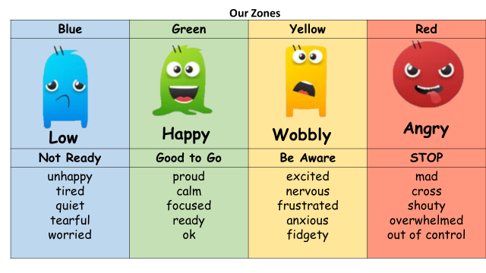
Zones of Regulation

Slide 7
Activity Time
Have a go at some of the activities with your child.
There is a list of instructions on each table and the adults will be able to answer any questions you have.
Feedback sheet.

Slide 8
Date for your diary
Wednesday 13th November 2024 – Little Wandle Phonics Workshop
8:55am – 9:45am
Looking forward to seeing lots of you there.

