Slide 1
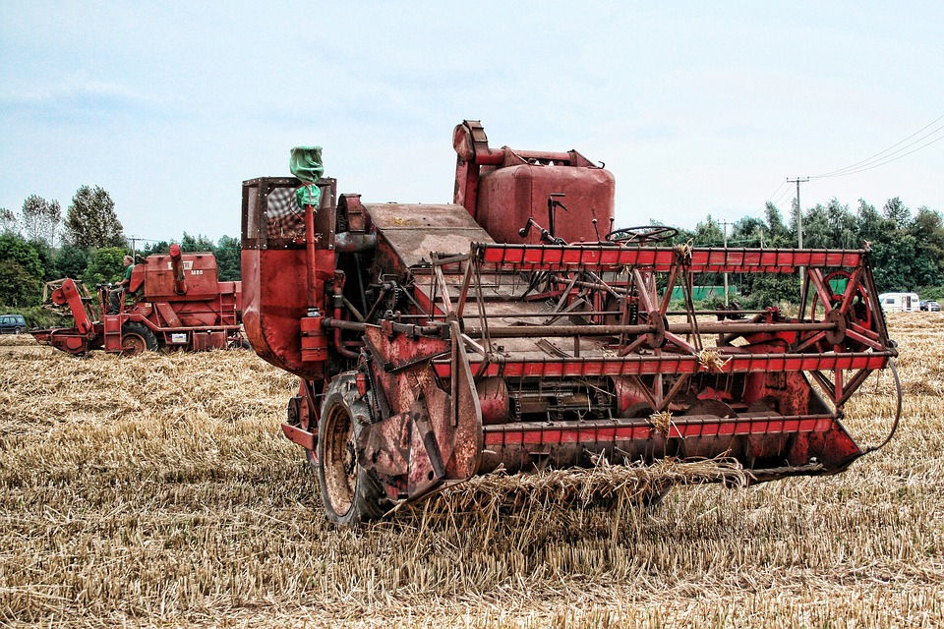
Big, Red
Combine Harvester
Click to play:

