Slide 1
Hillshott Infant School and Nursery
Welcome to Year 1

Slide 2
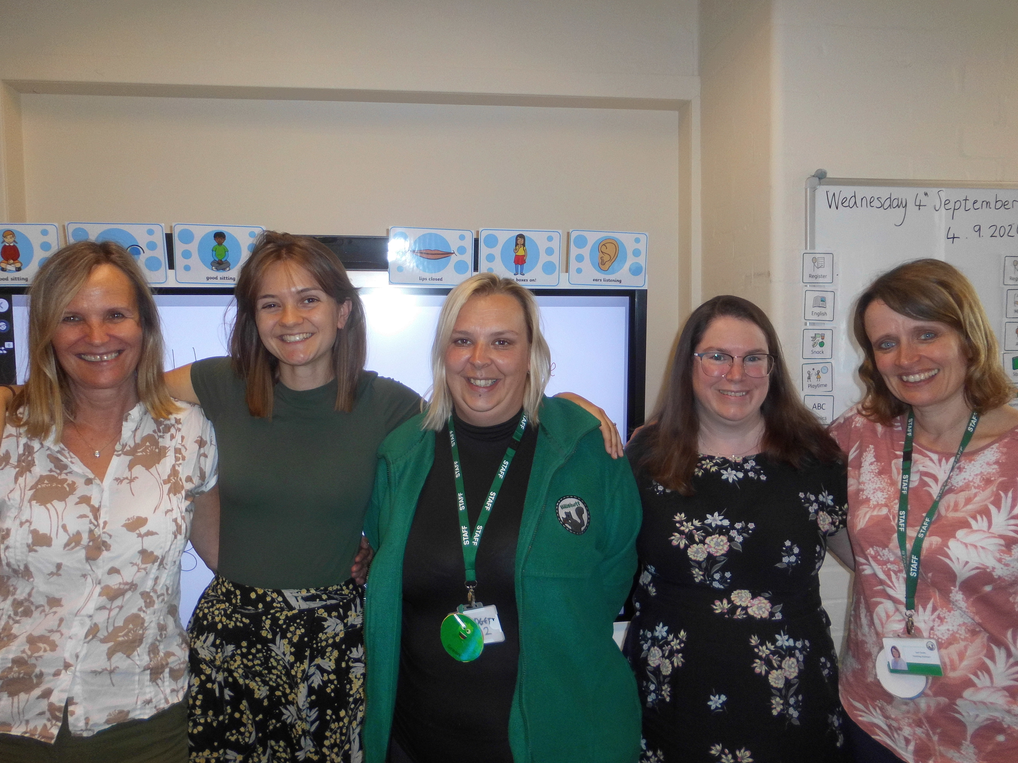
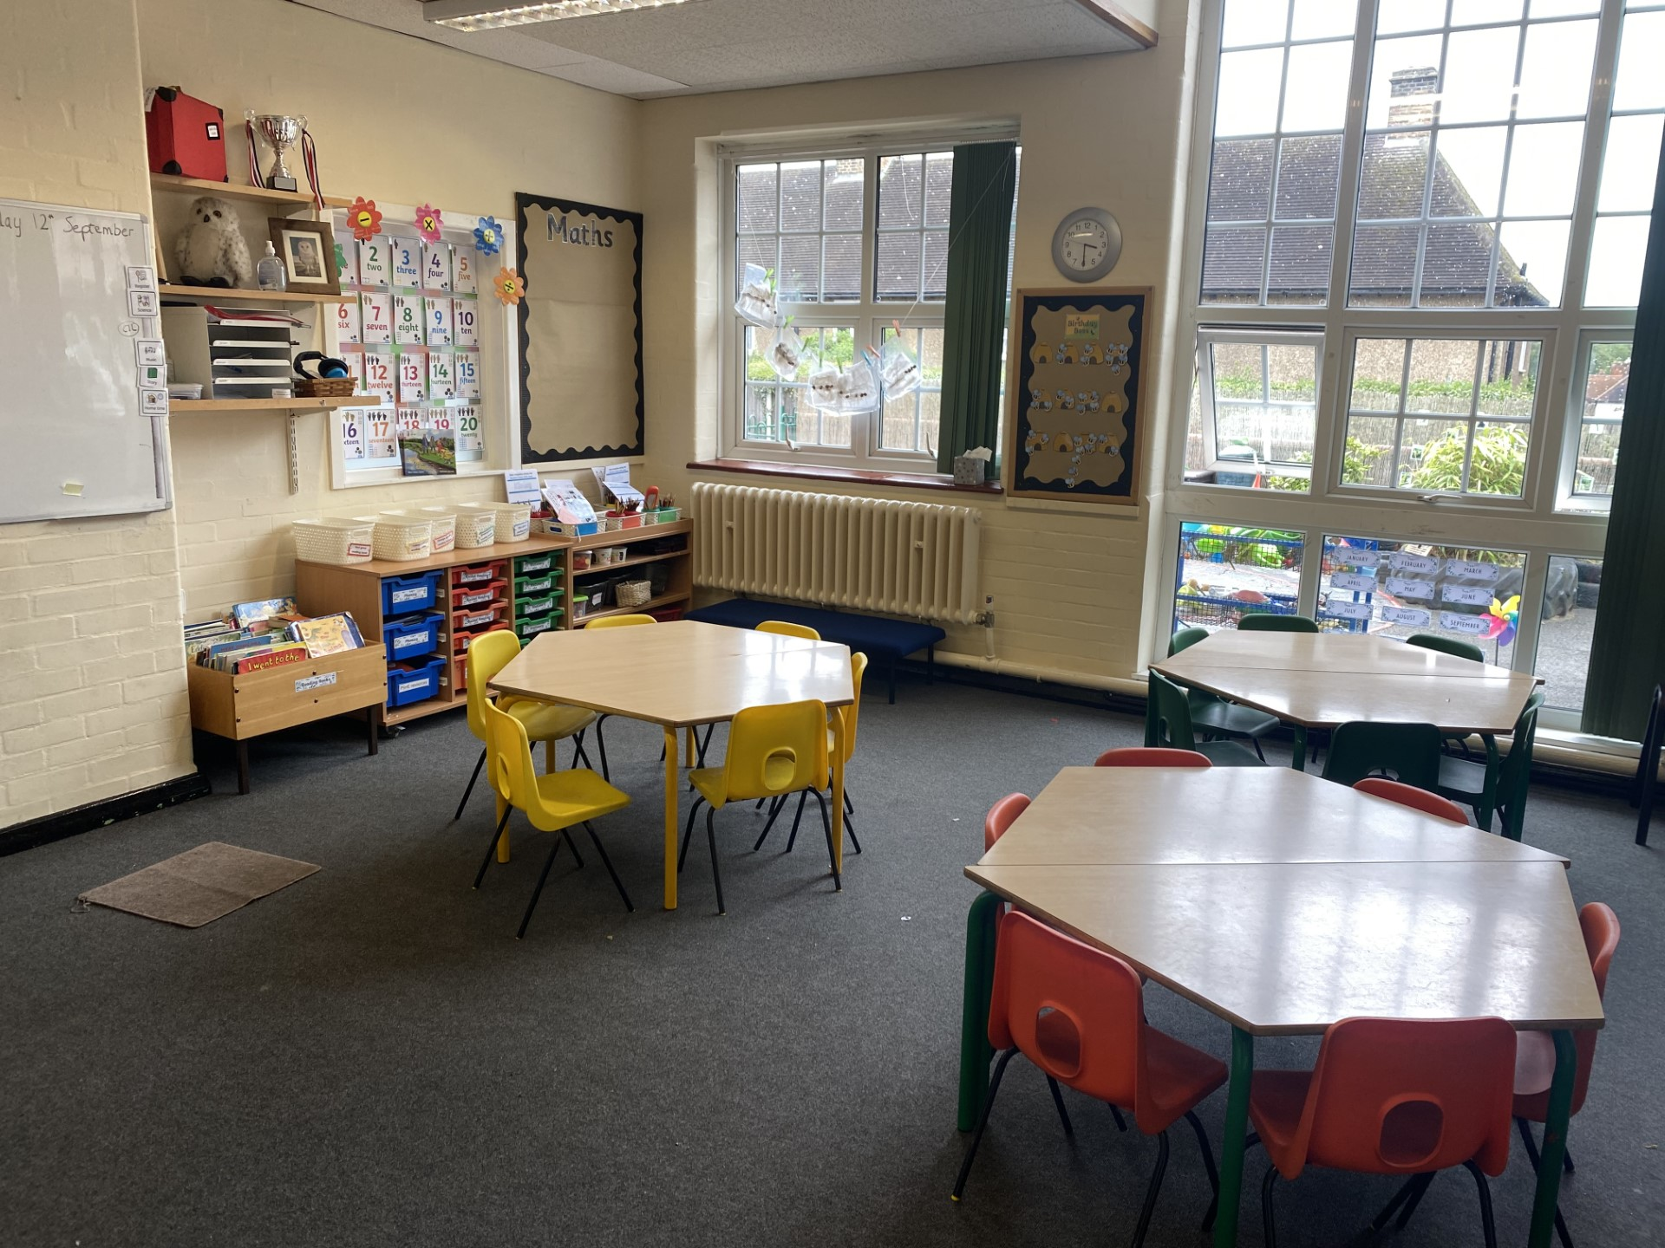
Barn Owls Class
Barn Owl Team
Mrs Northern, Mrs Anthony, Mrs Danks, Mrs Carter and Mrs Padgett
Barn Owls Classroom

Slide 3
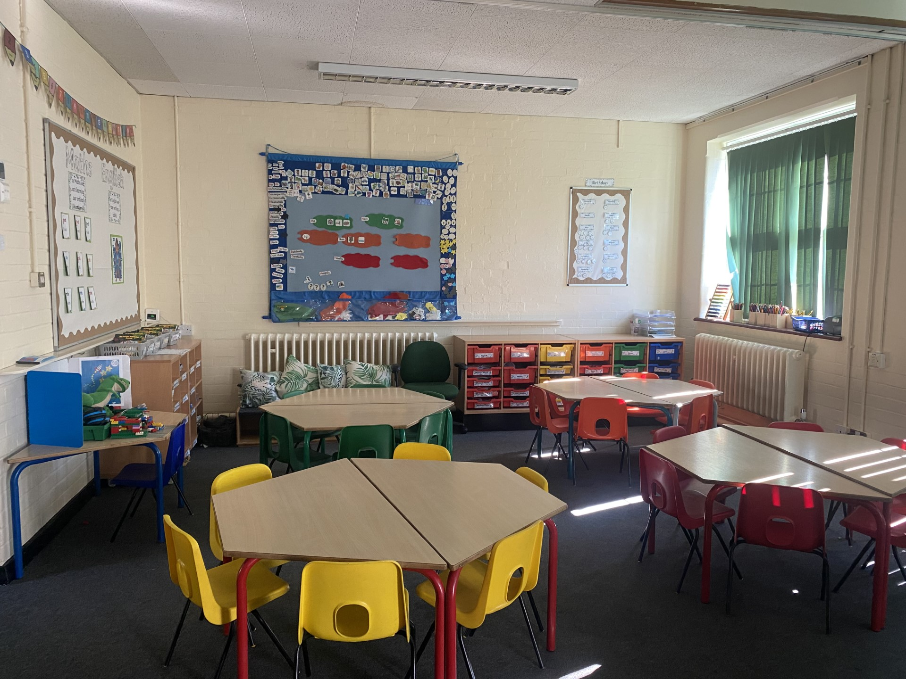
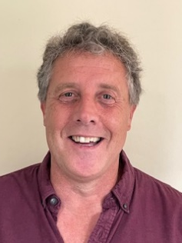
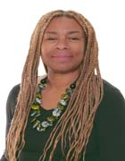
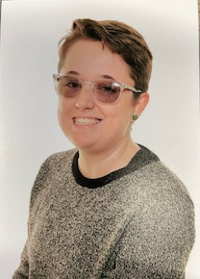
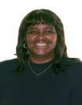
Kingfisher Class
Kingfishers Team
Mr Blyth, Mrs Macfarlane-Cushing, Mr Howard and Mrs Lalite
Kingfisher Classroom

Slide 4
Difference from Reception
Introducing formal learning at tables and beginning to use books to record our learning.
More responsibilities for the children. They will be expected to be independent and look after their own things.
Lunch starts at 12:10.
Snack time is in the classrooms just before break. It is up to the children to go and choose a snack from our class box. We sometimes have the opportunity to have another snack with our story at the end of the day.

Slide 5
Our Learning experiences
We have Maths, English and Phonics lessons everyday.
We have a different topic each half term and all our learning will be centred around this. This half term our topic is ‘Into the woods’ and you can find out more information about each half terms topic on the class pages.
We learn inside, outside and gain experiences through trips.
We have fun and practical learning experiences.
We have PE lessons twice a week. We try to teach this outdoors whenever possible, so please always have an outdoor PE kit and trainers in school.

Slide 6
Daily Routine
The doors open at 8:40 am.
There will be morning activities for children to do when they come into school e.g. fine motor activities, name writing or maths challenges. They also have the opportunity to eat a bagel.
As the children enter the classroom they hang up their coats and book bags on their peg and put away their packed lunches. Children are responsible for taking their reading record and reading book out of their book bags. Please bring these everyday.
If your child has a letter for the teacher or office it is their responsibility to get it out of their book bag and give to the teacher.
Playtime is at 10:20am.
Lunchtime is at 12:10 until 1:10pm.
Home time is at 3:10pm

Slide 7
House Keeping
Your child must bring their reading record and reading book to school everyday. Please write in their reading record when you have listened to them read. When you read 3 or more times a week with your child their name will be entered into our weekly bookworm award for a chance to win a bookmark in Friday’s assembly.
We give out homework and spellings on Fridays starting after October half term.
Homework (in a red folder) should be handed in by Wednesday the following week.

Slide 8
Thank you for listening
If you have any questions, please do not hesitate to speak to us at the end of the day.
We look forward to learning with your children this year.
Mr Blyth, Mrs Northernand Mrs Anthony

