Slide 1
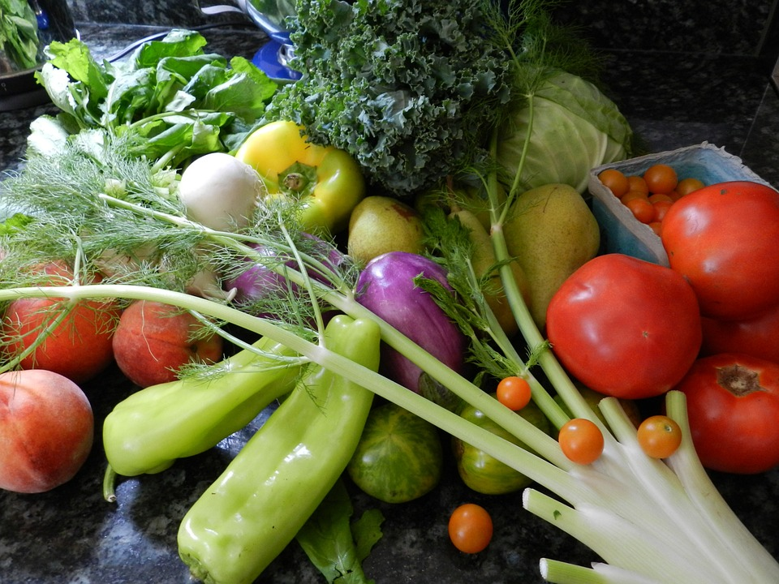
The Vegetable Song
Click to play:

