Slide 1


Hillshott School Nursery
Welcome to Reception

Slide 2

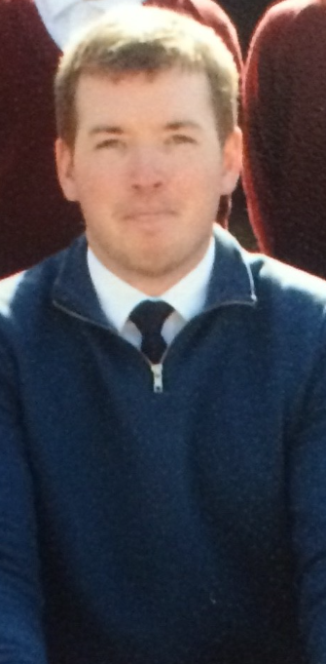
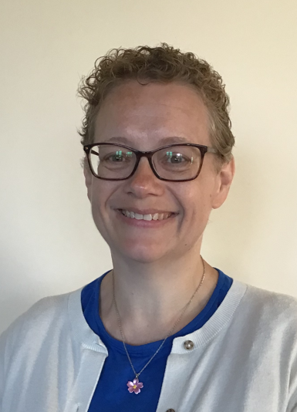
The Reception Team
Mrs Turner
(2 mornings a week)
Mrs Mountney
Early Years Leader- DDSL
Class teacher-Swifts
Mr O’Halloran
Class teacher-Robins
And a team of teaching assistants who work closely alongside the staff.

Slide 3
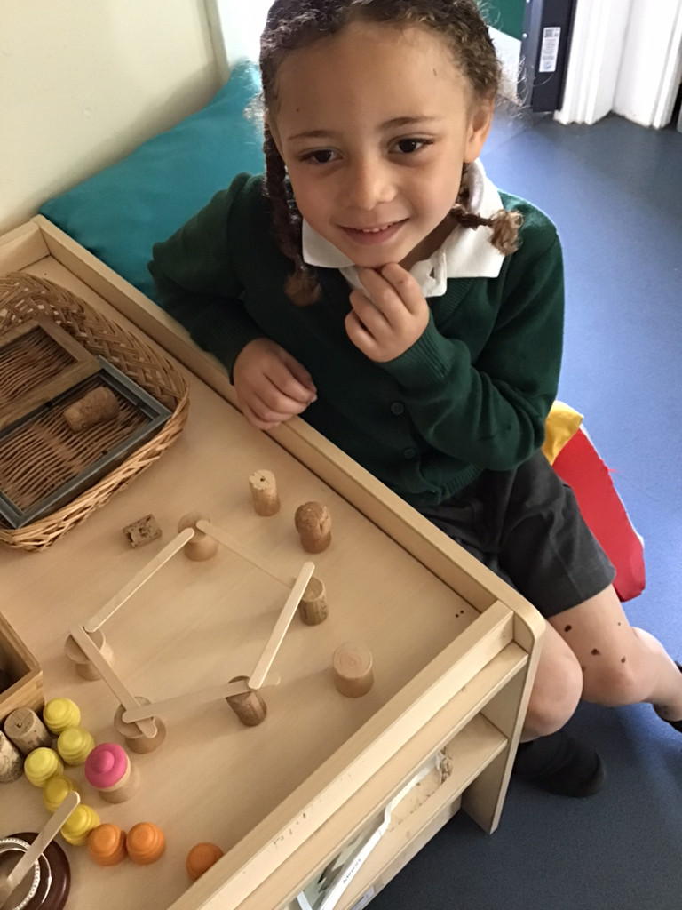
Early Years Curriculum
There are 7 areas of learning, 3 areas are prime areas and 4 are specific. Prime areas are fundamental and work together to support development in all other areas.
Prime Areas:
Communication and Language
Personal, Social and Emotional Development
Physical Development
Specific Areas:
Literacy
Maths
Understanding the World
Expressive Art and Design

Slide 4
Daily Routine
8.40am Doors open, children come in hang their book bags and coat on their peg and wash their hands.
8.50am Register and phonics
9.20am Child-Initiated Learning
10.30am Snack and story
10.40am Dance/Brain break/Mindfulness
10.45am Child-Initiated Learning
11.25am Maths/Reading
11.45am Wash hands for lunch

Slide 5
Daily Routine
12.20 Lunchtime play
1.10pm register, story
1.20pm Maths, Reading
1.30pm Child-Initiated Learning
2.40pm Tidy up time
2.50pm Singing and story
3.10pm Home time

Slide 6
Families as Partners
You will be invited to join us for parents evening and information events such as workshops.
Look at your child’s Tapestry account together, encourage children to tell you about their photos. You will be asked to share some of your child’s learning and achievements form home.
Weekly videos are sent out via Tapestry of staff reading our Story of the Week.
Weekly newsletters are emailed and are available on the website.
Family Friday’s offer opportunities for families to stay and play and complete learning challenges together.

Slide 7
Learning Journals
Personal to each child.
Updated regularly by all members of staff.
Contains information about what your child can do and what they need to focus on next to make progress.
Journals are completed using an online app called Tapestry. Parents can log in and view their child’s observations, comment on them and upload their own photos and video from home. More information about accessing this app will be available in September.

Slide 8
Ready to Learn
Helping your child prepare for school:
Being independent in their self-care including taking themselves to the toilet, putting their own coat and shoes on and dressing and undressing.
Being involved in cleaning and tidying.
Talking and listening to each other.
Working out a family routine.
Getting enough sleep.
Setting rules and boundaries.

Slide 9
What to Bring to School
Your child will need some named essentials with them everyday in Reception.
A book bag and a named water bottle.
A spare change of clothes.
A P.E kit consisting of a white top and a pair of shorts in a named bag for P.E. (A pair of plimsolls in the summer).
They will need to wear sensible shoes (avoid laces) and a coat as we use the outdoor learning environment in all weathers.
They may also bring a pair of wellingtons that can be left at school although we do have lots of spare pairs.
When it is hot they need sun cream applied before school and a sun hat to wear.
Please ensure ALL items are named.

