Slide 1

Marvellous Maths
In Early Years our curriculum is broken down into two parts:
Prime areas of learning: Communication and Language
Physical Development
Personal, Social and Emotional Development
Specific areas of learning: Literacy
Maths
Understanding the World
Expressive Art and design

Slide 2
What does maths look like in reception?
All activities are practical
Daily discrete maths lessons
Numberland sessions at least once a week
Maths Challenge table
Outdoor maths

Slide 3


End of Reception expectation in Maths
ELG- Number
Children will have a deep understanding of number to 10 including the composition of each number
Subitise (recognise quantities without counting) to 5
Automatically recall number bonds up to 5 (including subtraction facts) and some number bonds to 10, including double facts.

Slide 4
End of Reception expectation in Maths
ELG- Numerical Patterns
Verbally count beyond 20, recognising the pattern of the counting system;
Compare quantities up to 10 in different contexts, recognising when one quantity is greater than, less than or the same as the other quantity
Explore and represent patterns within numbers up to 10, including evens and odds, double facts and how quantities can be distributed equally

Slide 5
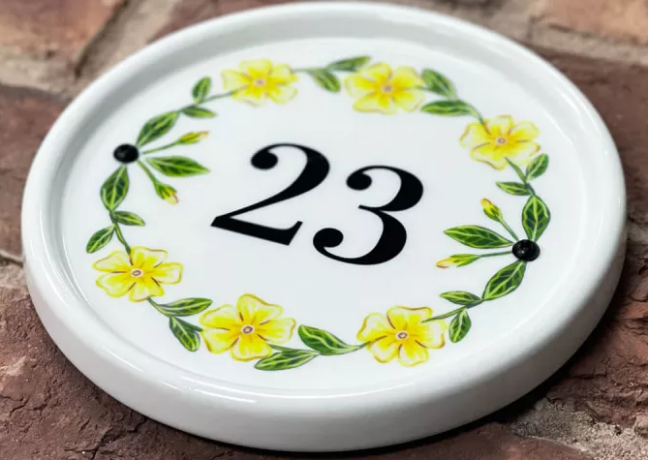

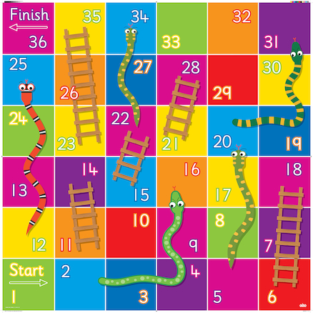
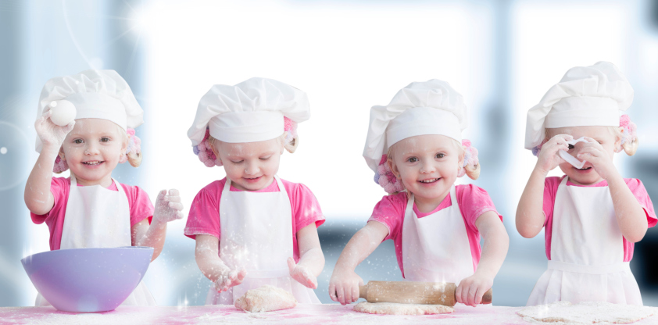
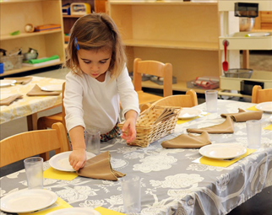
How can you support your child at home?

Slide 6
Activity Time
Have a go at some of the activities with your child.
There is a list of instructions on each table and the adults will be able to answer any questions you have.

